Slide 1
February 11th
*Parkinson’s disease: Neurological pathways
*Alpha-synuclein and mitochondrial fragmentation:
GAIN OF TOXIC FUNCTION in PD
*PINK1 and Parkin: A system to support the removal of disfunctional mitochondria:
LOSS OF PHYSIOLOGICAL FUNCTION IN PD
* Toxins and Therapy of PD

Slide 2
Symptoms in Parkinson’s disease
-Resting tremor (a tremor of a limb that increases when the limb is at rest)
-Bradykinesia (The slowing down and loss of spontaneous and voluntary movement)
-Rigidity (increased resistance to the passive movement of a limb)
-Postural Imbalance (incapability to keep a steady posture)
-Difficulties in the speech
A patient “qualifies” for PD when he/she has at least two of these symptoms

Slide 3
Parkinson’s diseases:
a neurodegenerative disease characterized by the loss of dopaminergic neurons in the Substantia Nigra pars compact (SNpc) and in the nigrostriatal pathway.
As a consequence:
THE DOPAMINERGIC SIGNALING IS IMPAIRED, THUS THE FUNCTIONS CONTROLLED BY DOPAMINERGIC SIGNALLING ARE LOST, RESULTING IN THE DISEASE, AND IN THE SYMPTOMS THAT CHARACTERIZE IT.

Slide 4
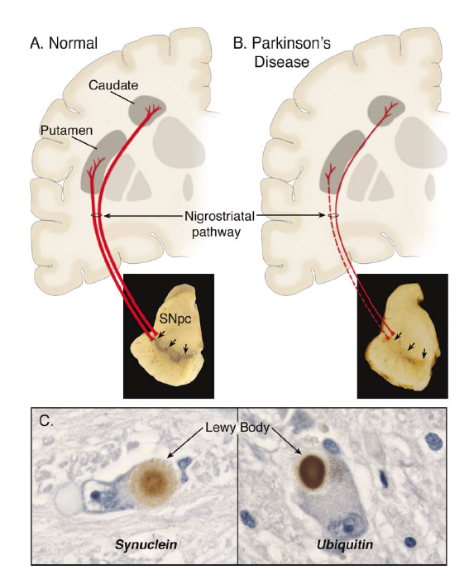
SNpc degeneration in PD
Dauer & Przedborski, 2003, Neuron 39, 889-909

Slide 5
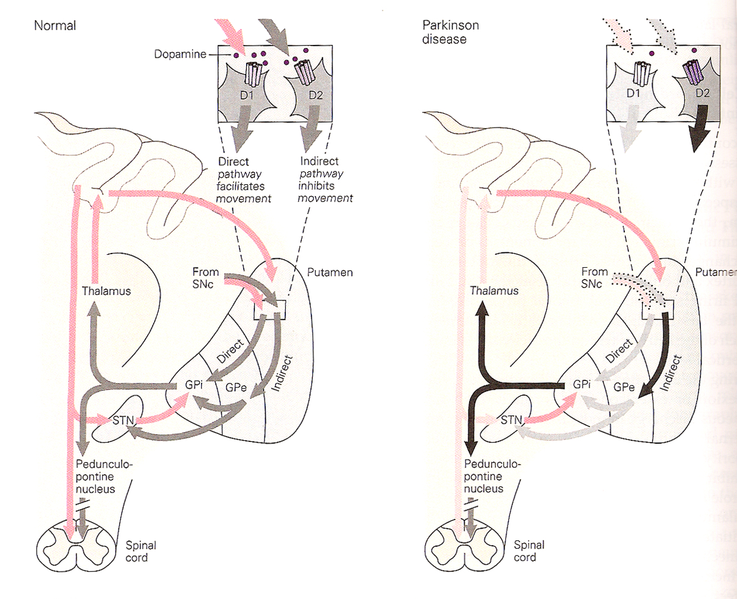
Dopaminergic Pathways in normal and PD: the direct and indirect ways
Kandel, Schwartz, Jessell “Priniciples of Neural Science”

Slide 6
Pathological hallmarks of PD
1- loss of nigrostriatal dopaminergic neurons
2-presence of proteinacious cytoplasmic inclusions, called Lewy Bodies (LBs)
3- the pattern of cell loss parallels the level of expression of the DA transporter (DAT)
4-At the onset of symptoms, DA is depleted ~80% and ~60% of Substantia Nigra Pars Compacta (SNpc) is lost.
5-More damage occurs at the nerve terminals, suggesting that dopaminergic nerve terminals are the primary target for the neurodegeneration.

Slide 7
Lewy Bodies
1-Intracellular lesions not specific of PD, but present also in certain cases of Dementia (Lewy Bodies Dementia).
2-Spherical eosinophilic cytoplasmic protein aggregates, measuring more than 15μM in diameter composed of :
α-synuclein, parkin, ubiquitin and neurofilaments.
3-Mechanism of toxicity not known: these aggregates could directly damage the cell by disrupting the intraneuronal protein trafficking, or by sequestering soluble proteins crucial for the life of the cell.
4-These inclusions may result from a process aimed at sequestering soluble misfolded proteins in the cytosol.

Slide 8
Risk factors
ENVIRONMENTAL/OCCUPATIONAL: direct correlation between these factors and PD
1-Exposure to toxins and pesticides (MPTP, rotenone, paraquat): from eating fruit and vegetables, to drinking well water. Significantly increased risk of developing PD among men who worked more than 10 years on a plantation. These substances inhibit the mitochondrial complex I, thus cause mitochondrial dysfunction.
2-Welding and exposure to heavy metals (such as zinc, amalgam, copper, lead, iron, manganese): they cause oxidative stress and production of ROS species.

Slide 9
Etiology of PD
GENETIC
SPORADIC
α-synuclein
Parkin
PINK1
LRRK2
UCHL-1
DJ-1
Environmental toxins:
MPTP
Paraquat
Rotenone
Cocaine
Endogenous toxins:
Reactive Oxygen Species (ROS)

Slide 10
α-synuclein mutations (PARK1/4)
A53T, A30P and E46K: TOXIC GAIN OF FUNCTION
None of these mutations have been found in sporadic cases of PD. These mutants are more prone to misfolding and aggregation compared to wild type α-synuclein.
A53T
-is the most aggressive form, in vitro it tends to shift into a β-sheet conformation more than the other mutants.
-Contursi kindred. Discovered in 1996 in an Italian village. Found also in a Greek kindred. Analysis of DNA mapped a 800kb region that overlapped in all the cases, meaning that all the patients derived by a common ancestor.
A30P
-discovered in 1998. Lower degree of penetrance and later onset than A53T (Penetrance: a term used in genetics to describe the extent to which the properties controlled by a gene, its phenotype, will be expressed).
Genomic triplication
Triplication of a 2 Mb genomic region containing the α-synuclein gene (Singleton, 2003). This results in overexpression of the gene for α-synuclein, thus in higher susceptibility to PD.

Slide 11
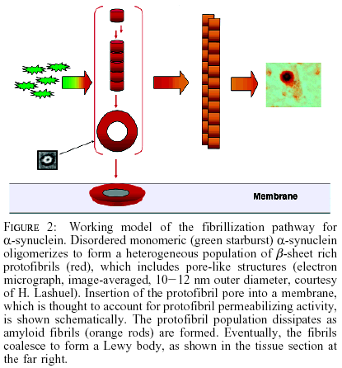
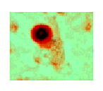
Model of α-synuclein fibrillization
Volles and Lansbury

Slide 12
Do oligomers damage membranes?

Slide 13
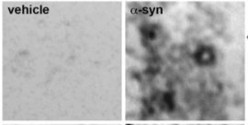
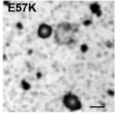
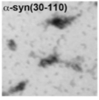
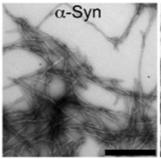
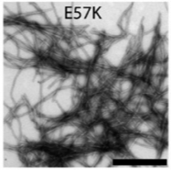
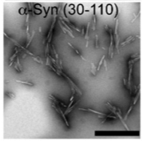
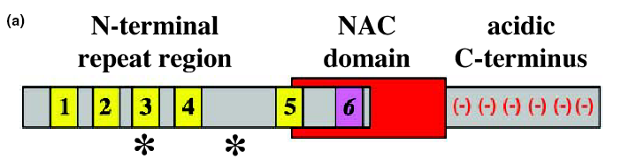
Fibrillar alpha-synuclein forms pore-like structures
E35
E57

Slide 14
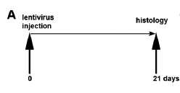
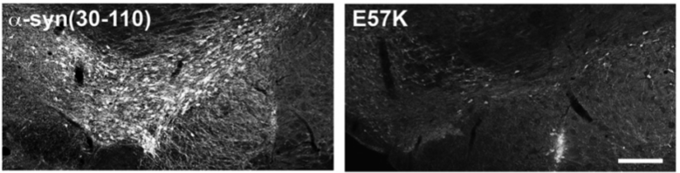
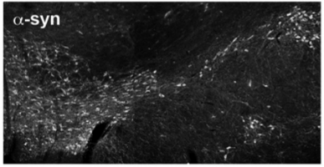
Overexpression of α-syn wt or variant is toxic
to dopaminergic neurons of SNPC
Tyrosine Hydroxylase staining

Slide 15
Disrupting the organization between α-helix and β-sheet strands improves the formation of oligomers, making the α-synuclein more toxic

Slide 16
Proposed mechanisms of toxicity of α-synuclein fibrils:
As lipid associated structure, they can disrupt membranes integrity, both plasma membranes and intracellular membranes causing:
*Disruption/damage of synaptic vesicles, altered release of neurotransmitter.
*Disruption/damage of ER and Golgi. This lead to ER stress and altered trafficking of proteins in the cell.
*Disruption/damage of mitochondria, causing mitochondrial stress, rupture, thus oxidation.
*Disruption/damage of proteasomes. Not clear whether this occurs because of a direct toxic function of α-synuclein on the UPP, or as a consequence of mitochondrial dysfunction.

Slide 17
Can α-synuclein oligomers cause mitochondrial damage in PD?

Slide 18
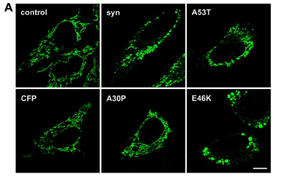
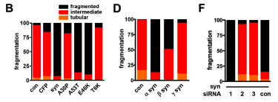
Overexpression of α-syn induces mitochondrial fragmentation

Slide 19
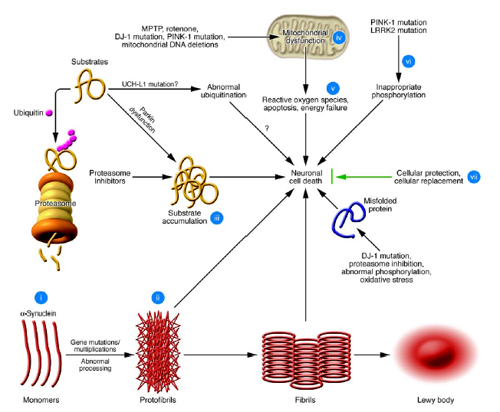
Loss of proteostasis causes loss of cellular homeostasis in PD

Slide 20
Correct proteostasis guarantees a protein’s function to ultimately maintain cellular homeostasis
Are there proteins that disrupt cellular homeostasis in PD?
Parkin and PINK1 as crucial regulator of Autophagy/Mitophagy.
Loss of function and gain of toxic function in PD.

Slide 21
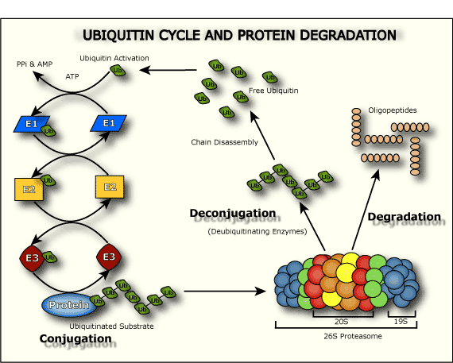
Parkin (PARK2)
1- Parkin is a protein-ubiquitin isopeptide ligase (E3), a component of the ubiquitin proteasome system that identifies substrates to drive them to the proteasomes for degradation (for review see Sherman and Goldberg, 2001)
Parkin

Slide 22
2- Parkin: ubiquitously expressed in the brain. Parkin-related PD is characterized by increased loss of dopaminergic neurons in the SNpc.
3- Mutations in Parkin cause a juvenile, autosomal recessive form of PD, with onset <30 years of age (ARJ-PD).
4- The gene for Parkin is expressed on chromosome 6. Parkin is a protein comprised of 465 aa, about 51.6 kDa.
5- Parkin is characterized by two RING finger domains rich in cysteins that confer the ubiquitin-ligase activity. RING1: aa238-293. RING2: aa418-449.
6- Parkin is expressed i) in the nucleus, ii) associates with synaptic vesicles, and iii) is found within actin and α- and β-tubulin positive microfilaments.
7- Parkin is itself ubiquitinilated.

Slide 23
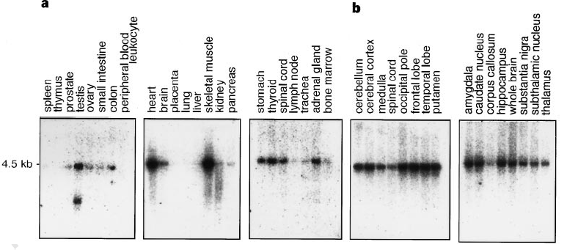
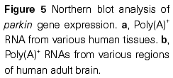
Parkin expression profile in human tissues
(Kitada, 1998)

Slide 24
Physiological function of Parkin
1- Protects from neurotoxicity induced by unfolded protein stress: overexpression of Parkin suppresses the stress caused by unfolded protein.
2- Among Parkin substrates are: Cyclin E (expressed in different neuronal populations, accumulates in the brain of sporadic and parkin-mutated PD patients), Synphilin1 (α-synuclein interactin protein, expressed in different neuronal populations).
3- One of the most important substrates for Parkin is CDCrel-1, a member of the septins family, GTPases required for the regulation of cytokinesis in the cell. CDCrel-1 is expressed mostly in neurons, at synaptic vesicles, and its accumulation reduces the pool of released DA in dopaminergic neurons (reviewed in Mizuno, 2001).
4- Binds to actin and α- and β-tubulin positive microtubules, and stabilizes them. This interaction and activity are independent on the E3 ligase property of Parkin. In this respect it could be speculated that the role of Parkin in microtubules is not only to stabilize them but also to anchor E3 ligase to them, enabling microtubules to control the amount of proteins that need to be degraded through the proteasomal pathway (Yang 2005).

Slide 25
Pathogenic mechanisms of Parkin
Loss of physiological function
1- Loss of E3 ligase activity that leads to accumulation of parkin substrates (synphilin 1 and cyclin E which accumulate in Lewy bodies structures, and accumulate in the brain of PD patients).
2-Loss of E3 ligase activity on Mfn2: defective mitophagy (ubiquitinilation of Mfn2 precedes the removal of damaged mitochondria).
3- Lack of ubiquitinilation of CDCrel-1: this may cause accumulation of CDCrel-1 and reduce the amount of DA released.
4-Oxidative stress.
Gain of toxic function
5-Covalent binding of Parkin to DA: changes in Parkin solubility, inactivation of Parkin E3 ligase activity (LeVoie, 2005).

Slide 26
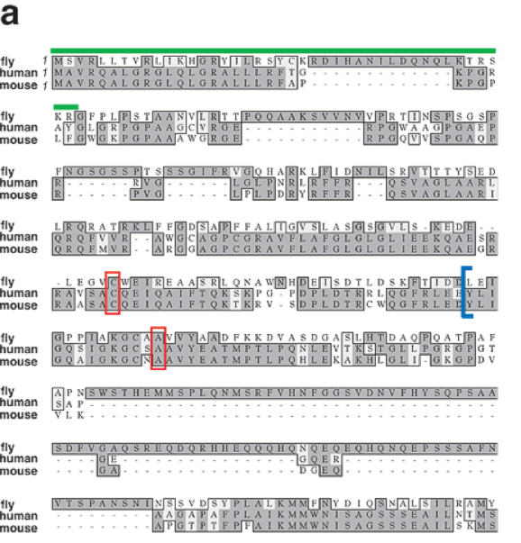
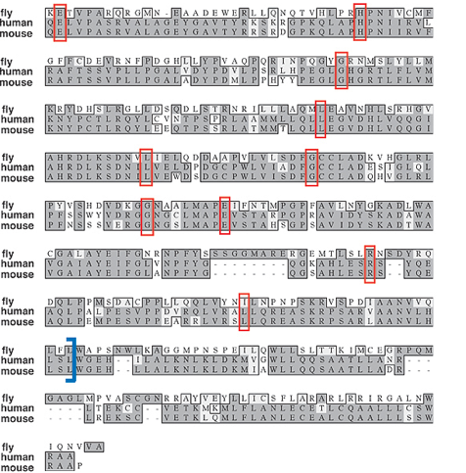
PTEN-induced putative kinase protein 1, PINK1
Dark: identical sequences; Light: similar sequences; Green: MTS, Mitochondrial Targeting Sequence; Blue Brackets: Kinase domain; Red Boxes: Conserved aminoacids altered by missense mutations.
Clark et al., 2006

Slide 27
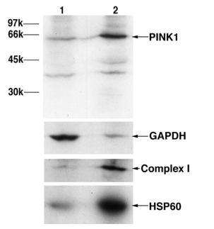
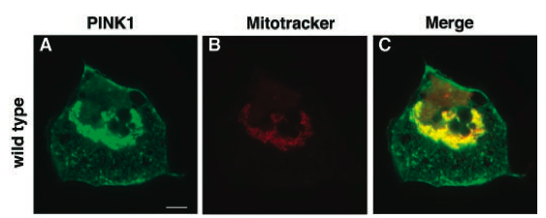
PINK1 localizes to Mitochondria
1=total lysate
2=mitochondria enriched fraction

Slide 28
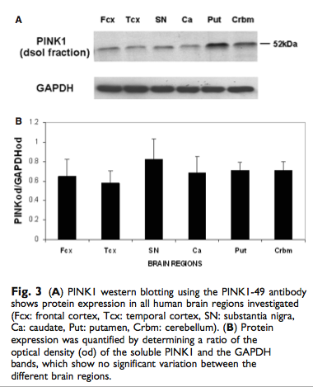
Expression of PINK1 in human brain areas

Slide 29
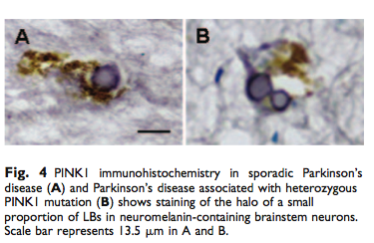
PINK1 co-localizes to Lewy Bodies in PD
Sporadic PD
PINK1 mutant PD

Slide 30
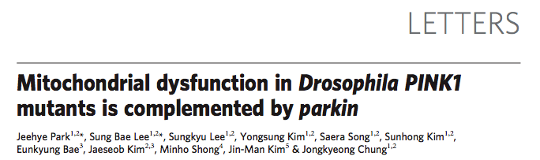
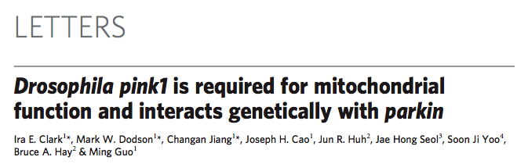

Slide 31
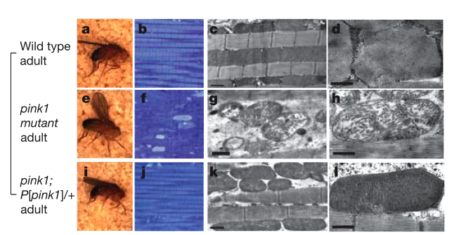
Muscle degeneration and mitochondrial cristae fragmentation are observed in adult PINK1 mutant flies
Rescue of the phenotype with PINK1 re-expression
Clark et al., 2006

Slide 32
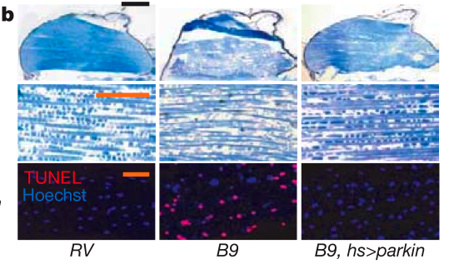
Parkin rescues the muscular structure and apoptosis in PINK1 mutant flies
Park et al., 2006

Slide 33
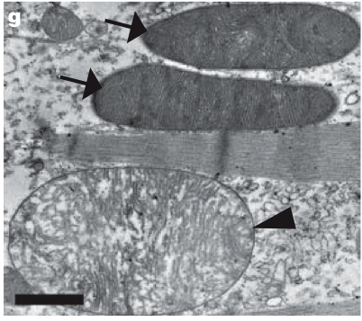
Parkin, like PINK1 re-expression, rescues the mitochondrial structure and cristae fragmentation
Parkin overexpression
Clark et al., 2006

Slide 34
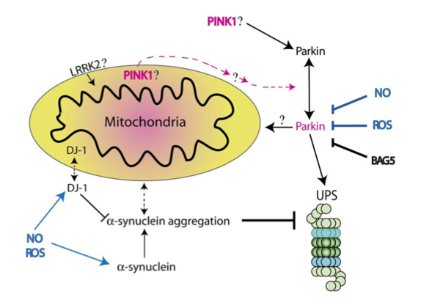
Parkin acts DOWNSTREAM of PINK1

Slide 35
PINK1 and Parkin function may be crucial to maintain
mitochondrial integrity

Slide 36
Commonalities between PINK1 and Parkin mutant
1-PINK1 knockout (mutant) phenotype resembles the phenotype observed in Parkin mutants flies (defective motor function).
2-PINK1 mutant flies have reduced ATP production, as a result of the mitochondrial dysfunction.
3-Dopaminergic degeneration is associated with structural mitochondrial abnormalities in PINK1 mutants.
4-In PINK1 mutants, muscle degeneration and mitochondrial fragmentation are associated with increased apoptosis.
5-Parkin rescues the phenotype caused by PINK1 mutant.

Slide 37
When working in the same pathway can PINK1 and Parkin regulate mitochondrial integrity?
Is this pathway affected in PD?

Slide 38
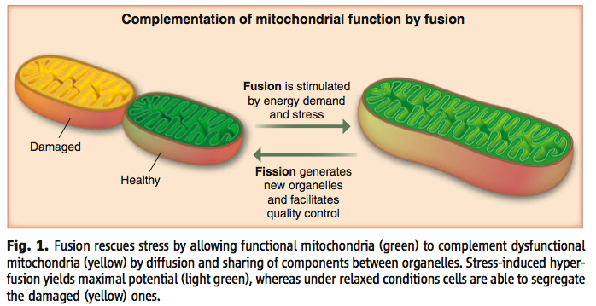
Fusion and Fission to facilitate quality control

Slide 39
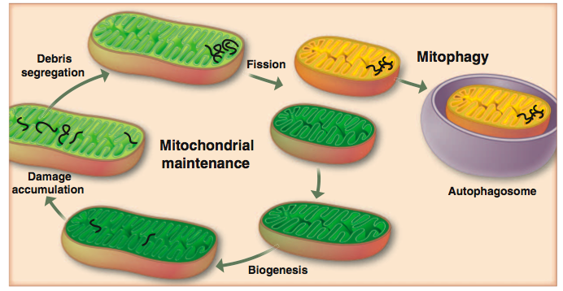
Mitophagy follows fission

Slide 40
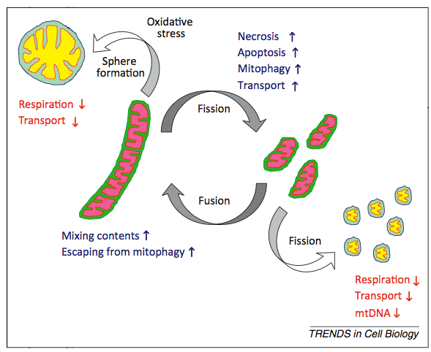
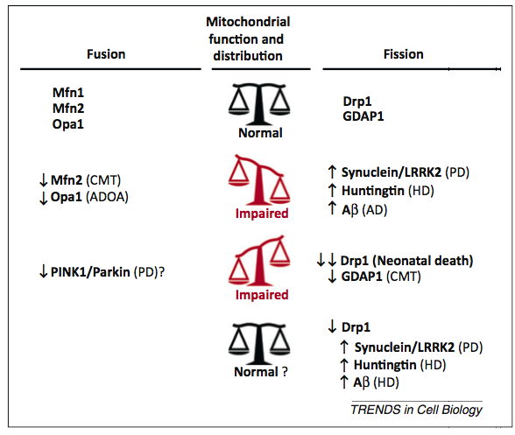
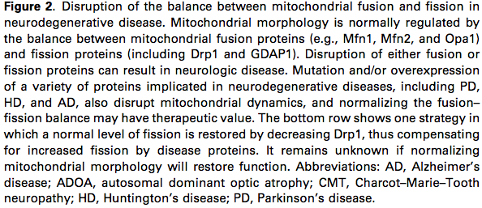
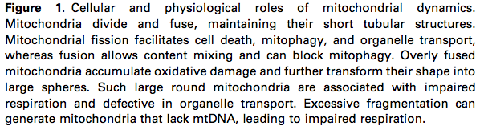
Mitochondrial dynamics in neurodegeneration
Physiologic Fission and Fusion
Balance or disease
Itoh et al., Trends in Cell Biology 2012

Slide 41
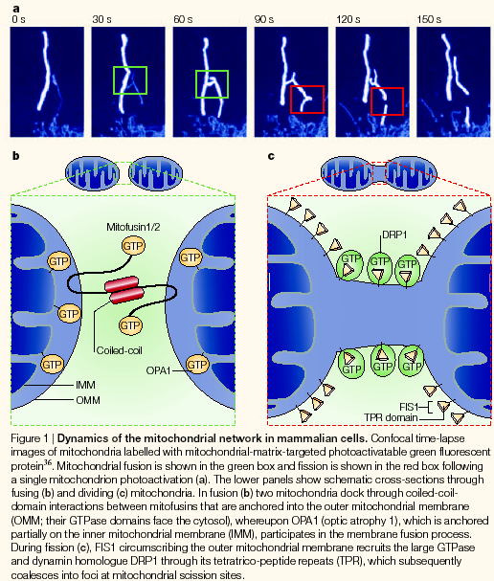
Fusion
Fission

Slide 42
Physiological role of mitochondrial fusion and fission
Mitochondria exist as dynamic structures that keep changing their size. Physiologic fusion and fission maintain the mitochondrial network.
During apoptosis, mitochondria undergo fragmentation, preparing the cell to a lack of provided energy. This leads to a contained programmed cell death.
Fusion and fission participate in apoptosis.
Inhibiting the activity of proteins underlying these processes results in inhibition of apoptosis. Up-regulating the activity of these proteins may promote apoptosis.

Slide 43
Proteins involved in mitochondrial fusion and fission
Fusion: dynamin-family members
MFN1, MFN2 mitofusin 1 and 2, impair mitochondrial fusion rate and shorten mitochondrial length. GTPase anchored to the outer membrane. N- and C-terminal domains face the cytosol, docking to each other and mediating docking of mitochondria to each other. Require GTP hydrolysis.
OPA1 optic atrophy 1 protein (gene mutated in most forms of hereditary blindness). Large GTPase expressed in the intermembrane space, is anchored to the inner membrane. Loss of OPA1 expression leads to mitochondrial fragmentation, whereas ectopic OPA1 expression leads to mitochondrial fusion that does not require MFN2.
Fusion occurs when both the inner and the outer mitochondrial membrane fuse: GTP hydrolysis necessary at both levels.
Fission
FIS1 binds to the outer membrane. The domain of the protein facing the cytosol binds cytosolic proteins involved in the fission, such as DRP1.
DRP1 dynamin regulated protein 1, it’s a cytosolic protein recruited to the mitochondrial outer membrane by FIS1, visible as punctate foci at the site of mitochondrial division on the outer membrane. It forms a ring around the mitochondrion and mediates constriction of the organelle at that point.

Slide 44
Analysis of a possible role for PINK1 and Parkin in mitochondrial fusion and fission.

Slide 45
1-Perturbation of mitochondrial fission could be a damaging cellular process involving Parkin and PINK1 in PD.
2-Accumulation of dysfunctional mitochondria may be toxic to the cell
Is fission related to disposal of mitochondria?

Slide 46
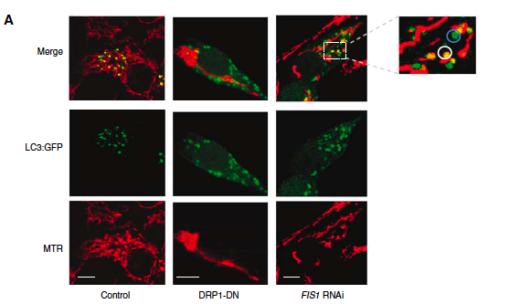
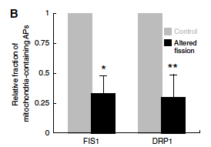
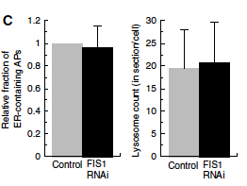
Fission increases disposal of mitochondria
via autophagic mechanisms

Slide 47
Mitophagy: autophagic disposal of mitochondria
How can PINK1 and Parkin regulate mitophagy?

Slide 48
Loss of mitochondrial membrane potential ΔΨm as a functional correlate to mitochondrial damage
ΔΨm as a signal to begin mitochondrial removal

Slide 49
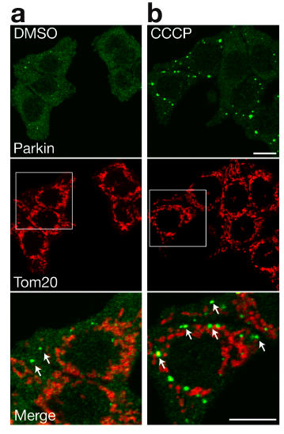
Depolarization recruits parkin to the outer mitochondrial membrane

Slide 50
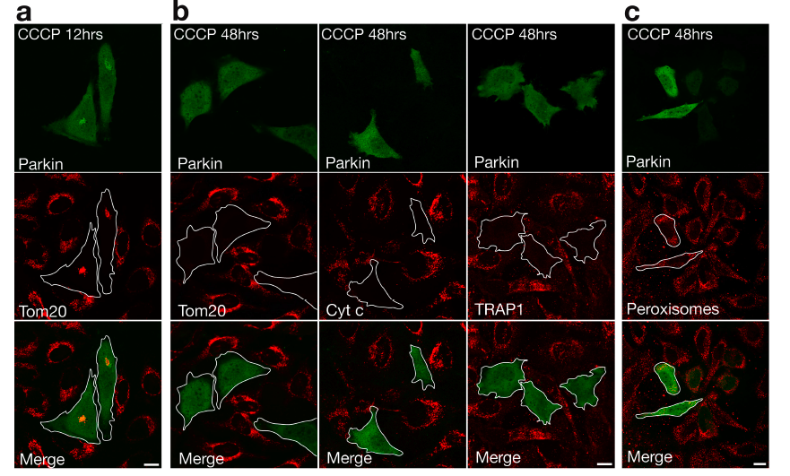
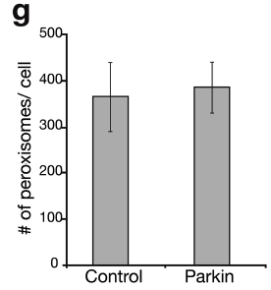
Depolarization induces parkin-mediated clearance
specifically of mitochondria

Slide 51
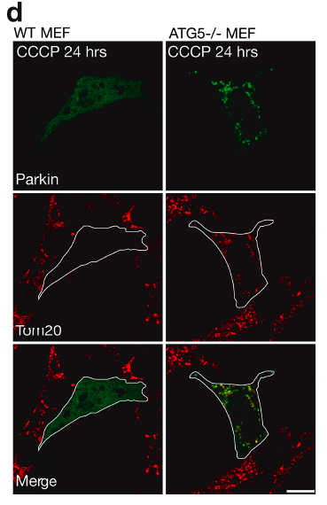
Parkin-mediated clearance of mitochondria occurs
via autophagic mechanisms

Slide 52
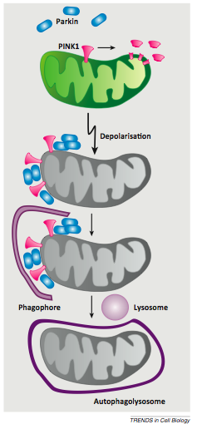
PINK1 and Parkin regulate Mitophagy

Slide 53
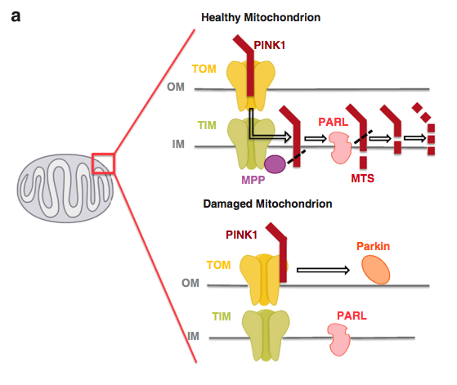
PINK1 stabilization in healthy and damaged mitochondria

Slide 54
Neurotoxins that induce PD

Slide 55
Neurotoxins that induce PD
- 6-hydroxydopamine (6-OHDA)
-Paraquat
-Rotenone
-MPTP
1-They all induce death of dopaminergic neurons;
2-they all increase the production of ROS;
3-they are all good models for the study of the mechanisms and treatments for PD.
4-However, only some cause death by apoptosis and induce accumulation of α-synuclein intracellular inclusions.

Slide 56
MPTP, 1-methyl-4-phenyl-1,2,3,6,-tetrahydropyridine
MPTP is a by-product in the synthesis of MPPP (1-methyl-4-phenyl-4-propionoxypiperidine, analogue of the narcotic meperidine-Demerol), an illicit narcotic drug.
MPTP causes severe, irreversible parkinsonism.
MPTP causes strong degenerations of dopaminergic neurons that contain neuromelanin. The mechanism is related to increased production of ROS, through interaction with iron in pigmented neurons (Zecca, 2001). Other substances interact with neuromelanin, suggesting that pigmented neurons are more susceptible to PD.
MPTP is highly lipophilic and crossed the brain/blood barrier very quickly.

Slide 57
MPTP: mechanisms of action
Generation of the active species MPP⁺ in glial cells.
MPTP targets specifically dopaminergic neurons or few other monoaminergic neurons.
MPTP is oxidized to MPDP⁺ in glial cells by monoaminoxidase B (MAOB). Then, MPDP⁺ is oxidized to MPP⁺.
MPP⁺ exits the glial cell, binds to the DAT (dopamine transporter) and enters the dopaminergic neuron. In this respect DAT activity and/or expression levels are crucial determinants in the susceptibility to PD.

Slide 58
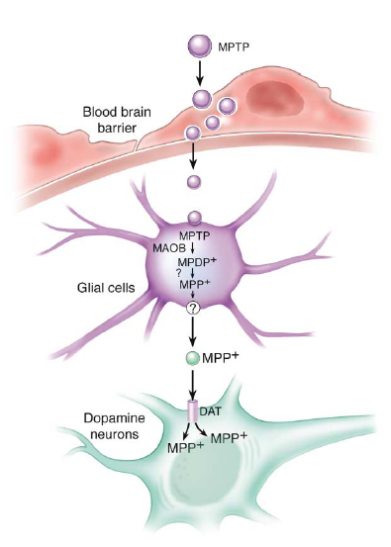
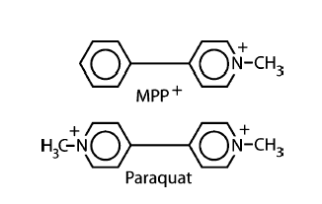
MPTP: mechanisms of action
Dauer & Przedborski, 2003, Neuron 39, 889-909

Slide 59

Degenerative mechanism of MPTP:
mitochondrial dysfunction through inhibition of the mitochondrial complex I
Dauer & Przedborski, 2003, Neuron 39, 889-909

Slide 60
Therapeutic approaches in PD

Slide 61

Dopamine synthesis and signaling: therapeutic approach
1
1-L-DOPA
2-MAOB Inhibitors
3- Dopamine Receptor agonists
4- COMT Inhibitors
4
2
3

Slide 62
L-DOPA: administered to favor the synthesis of dopamine, remains the most effective medication for PD, and the “gold standard” used to measure all treatments for PD, and to diagnose it (if the patient is responsive to L-DOPA, thus it is PD).
Administered together with Carbidopa, to reduce the amount of L-DOPA converted into dopamine in the blood. In this way, more L-DOPA is converted into dopamine in the brain, and smaller doses of L-DOPA lasts longer. After long time of treatment, L-DOPA will eventually stop working.
MAOB inhibitors: used to reduce the degradation of dopamine. Selegiline. Used both in the early and late stages of the disease, it improves the effects of L-DOPA.
Dopamine receptors’ agonists: they stimulate dopamine receptors mimicking the structure of dopamine. In this way they promote signaling in dopaminergic neurons. (Bromocriptine, Pergolide, apomorphine hydrochloride, Ropinirole).
COMT inhibitors: Entacapone, Tolcapone. They inhibit the action of COMT, catechol O-methyltransferase, an enzyme that degrades L-DOPA by catalyzing the methylation of one of the hydroxyl groups in the cathecol nucleus. Administered in the therapy with L-DOPA.

Slide 63
Deep Brain Stimulation (DBS)
“Deep brain stimulation (DBS) is a surgical procedure used to treat a variety of disabling neurological symptoms—most commonly the debilitating symptoms of Parkinson’s disease (PD), such as tremor, rigidity, stiffness, slowed movement, and walking problems.
DBS uses a surgically implanted, battery-operated medical device called a neurostimulator—similar to a heart pacemaker and approximately the size of a stopwatch—to deliver electrical stimulation to targeted areas in the brain that control movement, blocking the abnormal nerve signals that cause tremor and PD symptoms.
The DBS system consists of three components: the lead, the extension, and the neurostimulator. The lead (also called an electrode)—a thin, insulated wire—is inserted through a small opening in the skull and implanted in the brain. The tip of the electrode is positioned within the targeted brain area.
The extension is an insulated wire that is passed under the skin of the head, neck, and shoulder, connectng the lead to the neurostimulator. The neurostimulator (the "battery pack") is the third component and is usually implanted under the skin near the collarbone. In some cases it may be implanted lower in the chest or under the skin over the abdomen.
Once the system is in place, electrical impulses are sent from the neurostimulator up along the extension wire and the lead and into the brain. These impulses interfere with and block the electrical signals that cause PD symptoms”.
From NINDS (National Institue of Neurological Disorders and Stroke)

Slide 64



Slide 65

Sites for surgical intervention in Parkinson’s disease

Slide 66





Models for PD
6-OHDA Treatment
MPTP Treatment

Slide 67

Animal models for PD: is there an ideal one?

